Slide 1


So I Was Going to Be an Astronomer…
From the night skies of northern Wisconsin and the University of Kansas, to cybersecurity.
Torry Crass
2026

Slide 2

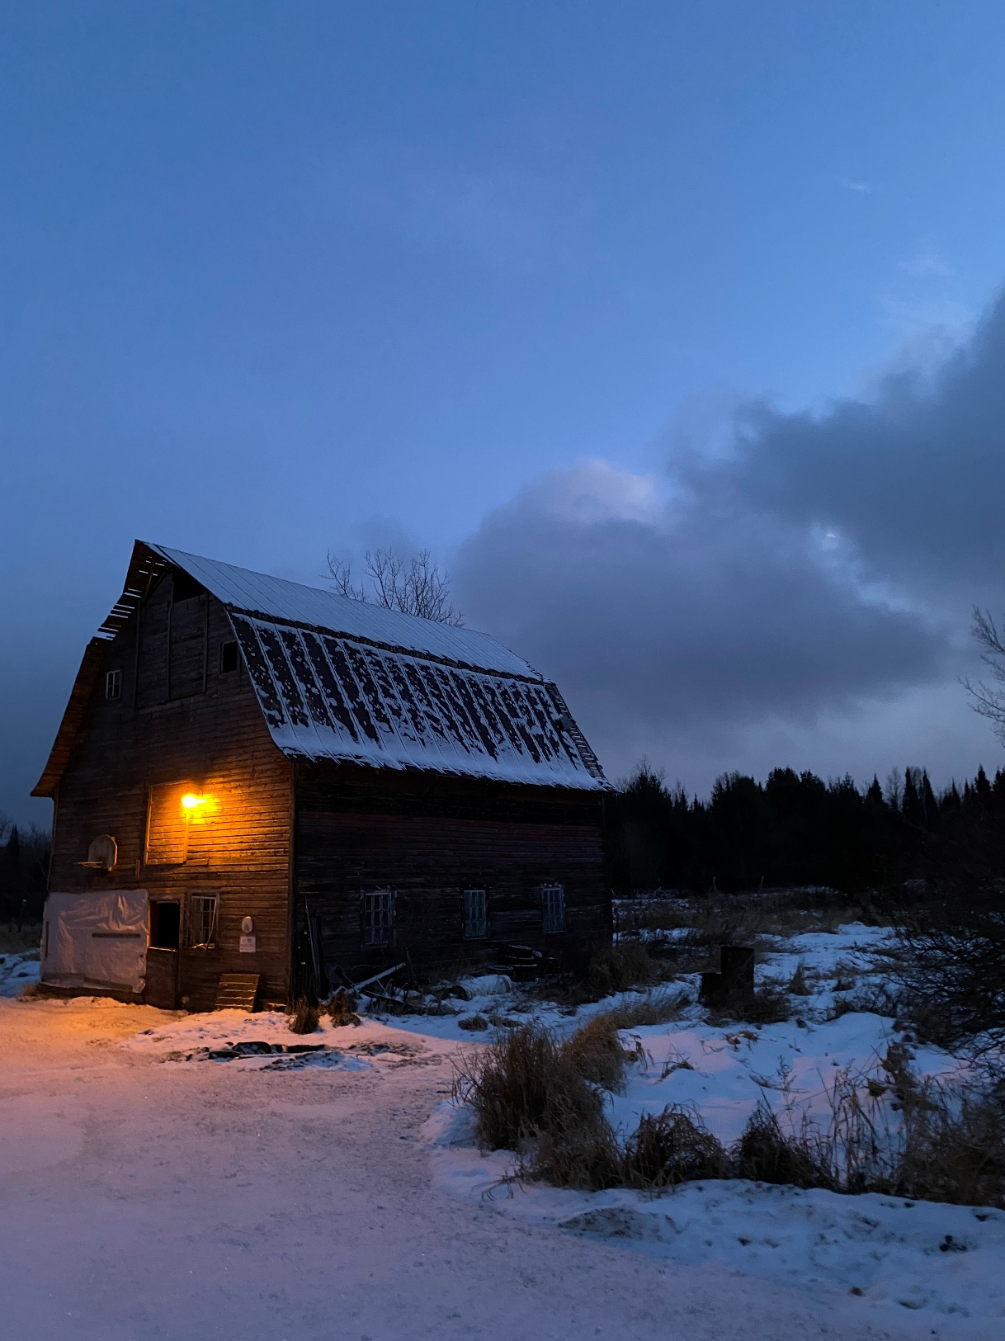
CHAPTER 01
The Beginning
Northern Wisconsin. A comet. And a phone call.

Slide 3

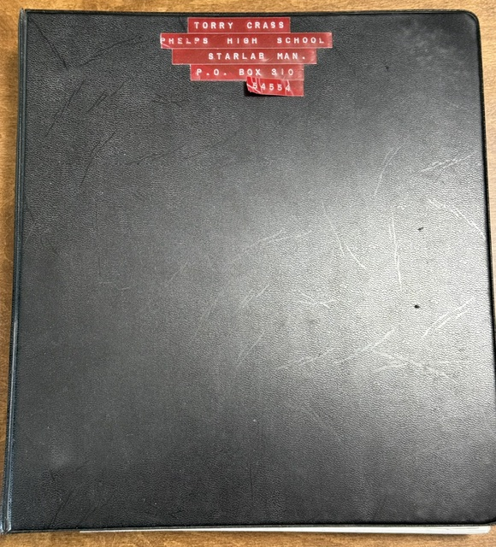
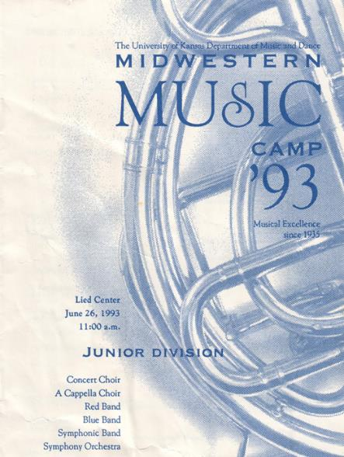
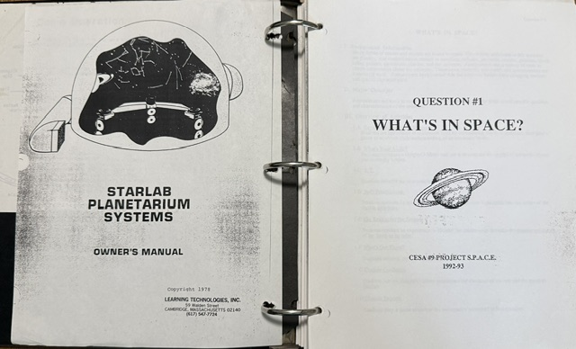
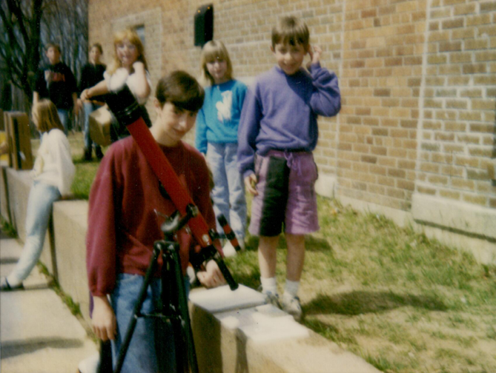
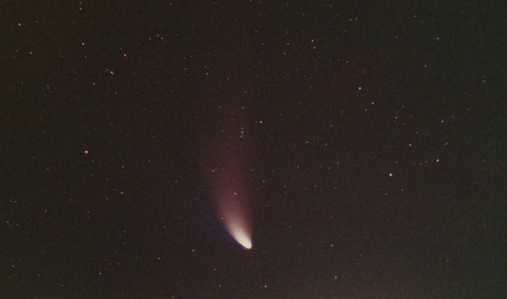
NORTHERN WISCONSIN · 1996
Stars, Comets, and Music?!?
Starlab, Eclipses, Hale-Bopp and Hyakutake. No light pollution.
A call from Professor Shawl and on to KU.
Comet Hyakutake: closest approach 0.102 AU, March 25, 1996 · Comet Hale-Bopp: perihelion April 1, 1997, visible for 18 months

Slide 4

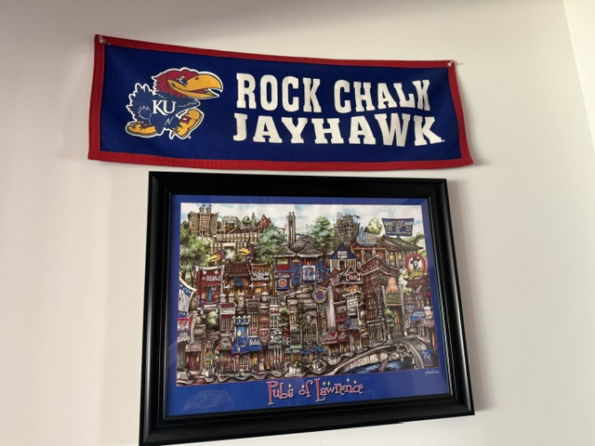
CHAPTER 02 · UNIVERSITY OF KANSAS
Here we go!
Rock Chalk!

Slide 5

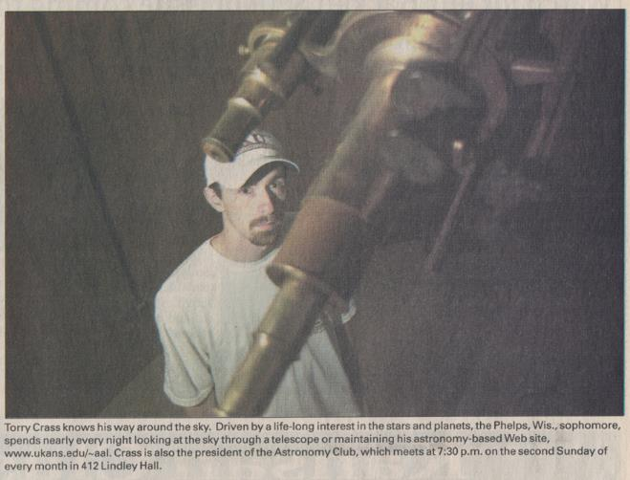
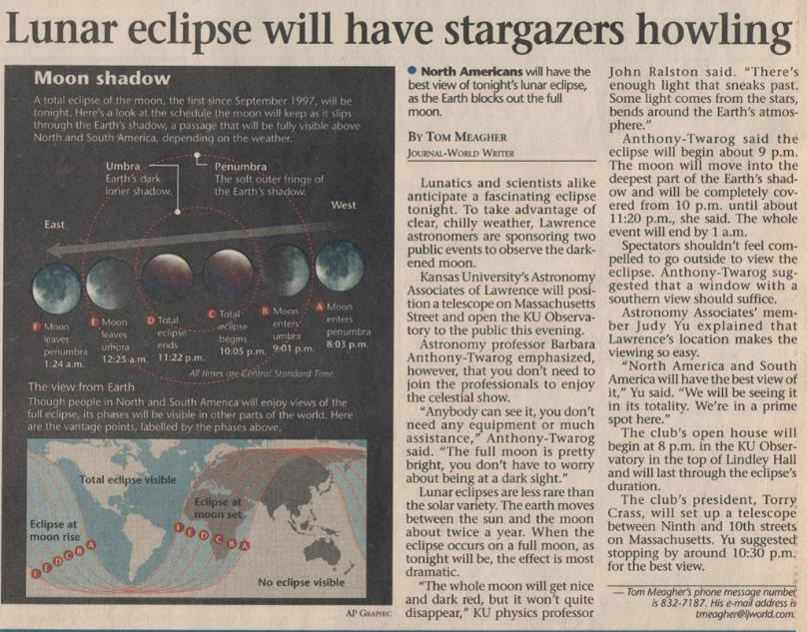
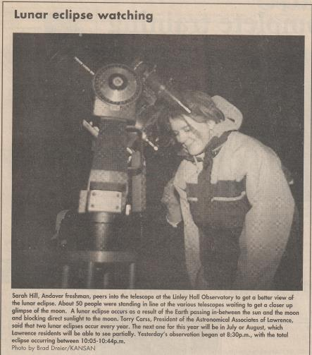
UNIVERSITY OF KANSAS · PHYSICS & ASTRONOMY
6”, 28”, 14”, so many telescopes!!

Slide 6
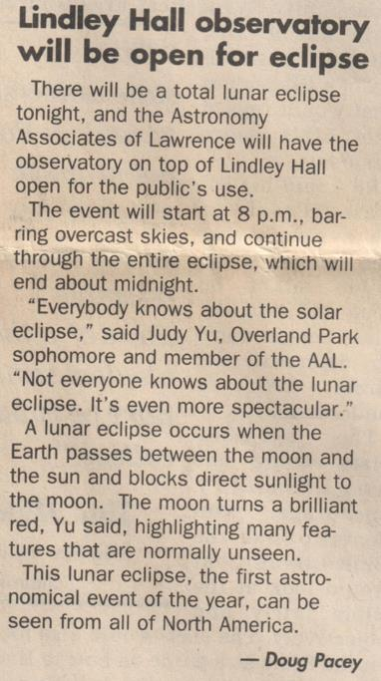
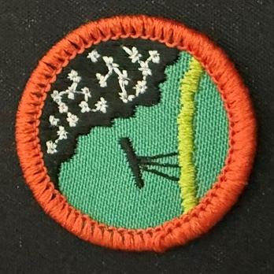
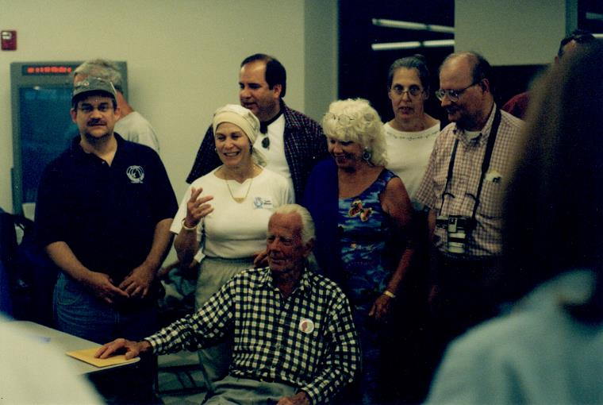
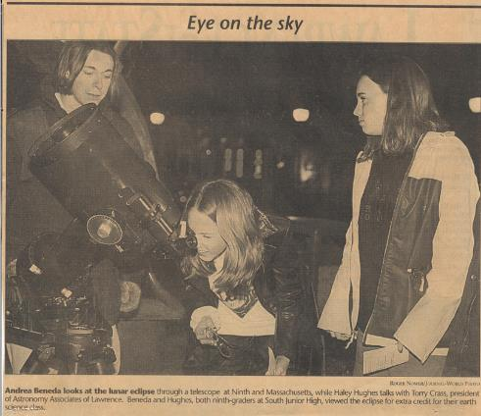
UNIVERSITY OF KANSAS · PHYSICS & ASTRONOMY
Dobson, Public Observing, Judy & Torry Get Patched.

Slide 7
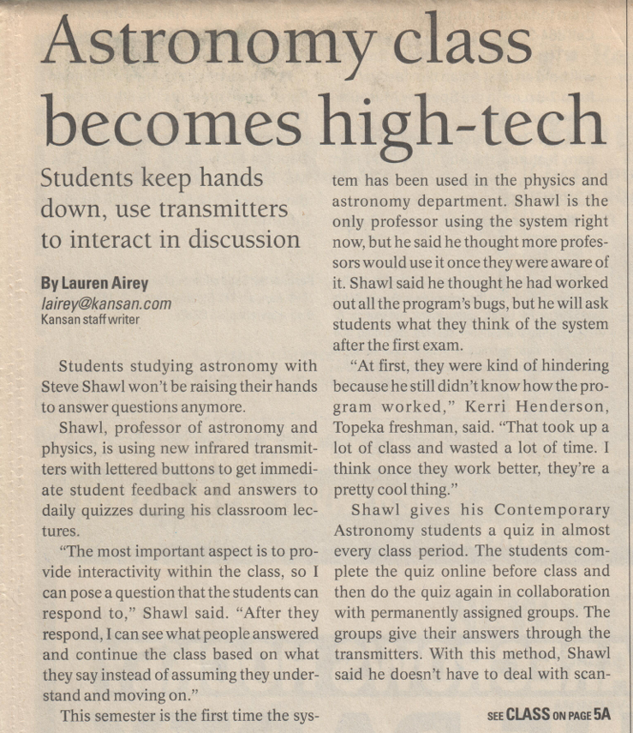
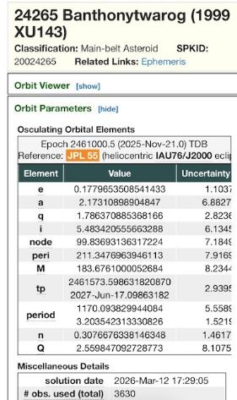
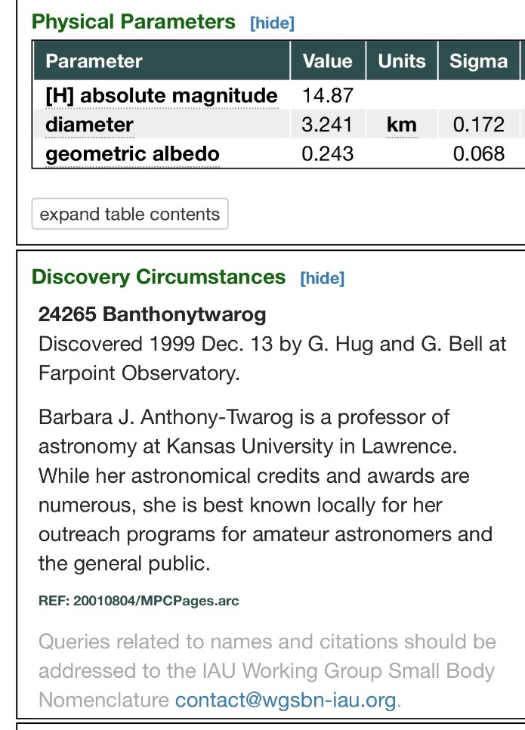
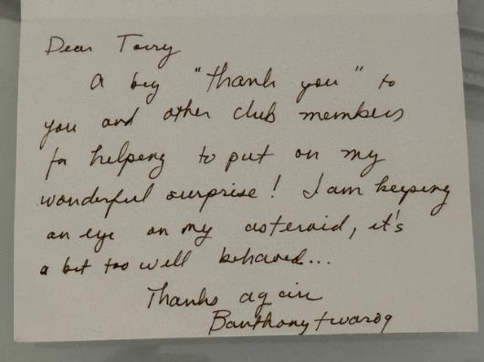
UNIVERSITY OF KANSAS · PHYSICS & ASTRONOMY
Torry Might Be A Pack Rat...
But, a thank you note, and Astronomy… High Tech?!?

Slide 8

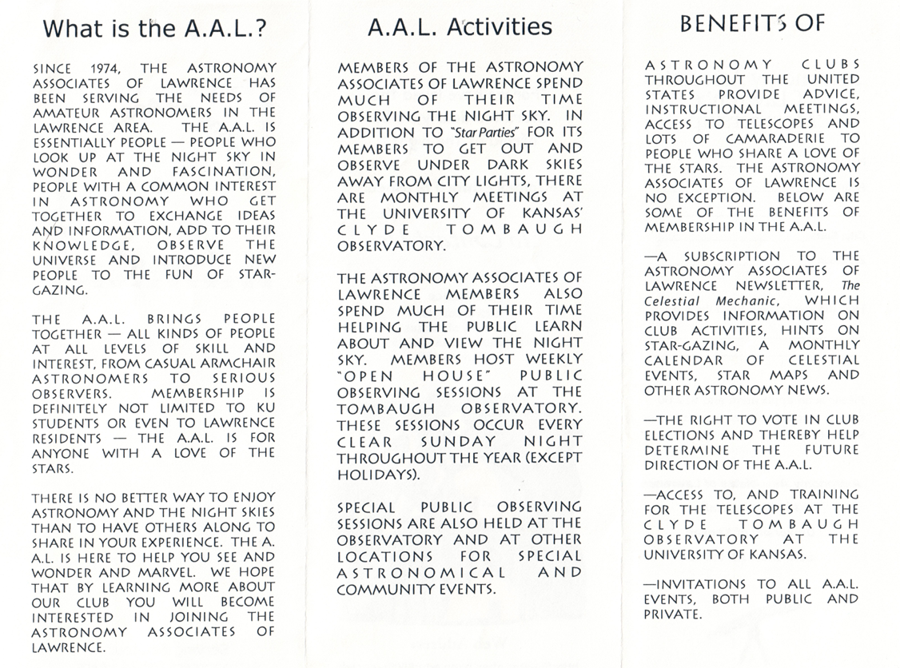
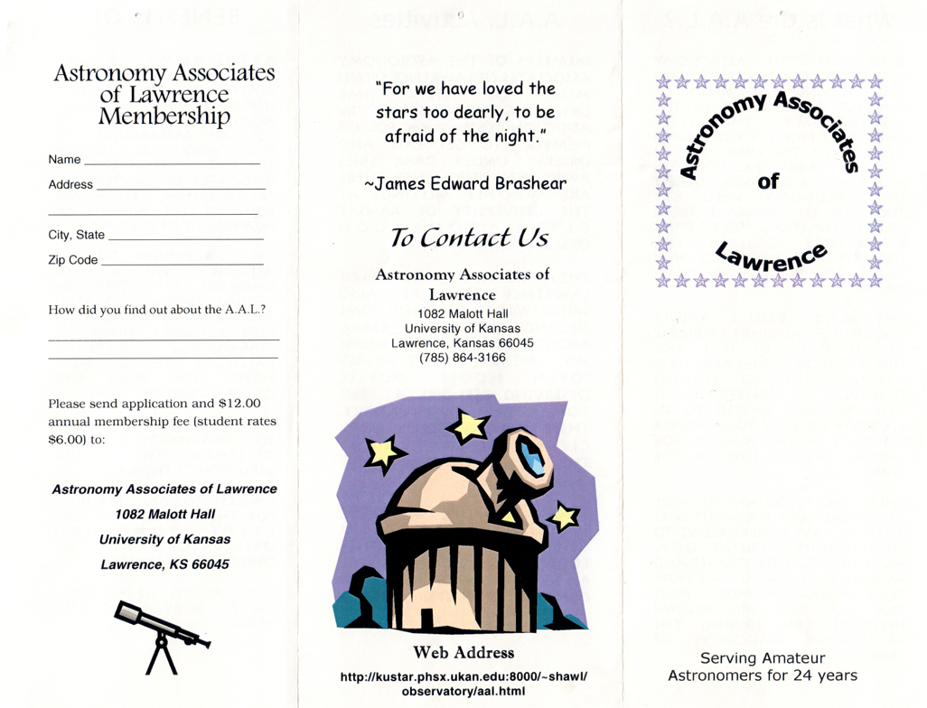
CHAPTER 03
Astronomy Associates of Lawrence
From 1997 until about 2001 when Judy Yu took over

Slide 9

ASTRONOMY ASSOCIATES OF LAWRENCE
RICK! I have something for you. I promise it’s not bad.

Slide 10

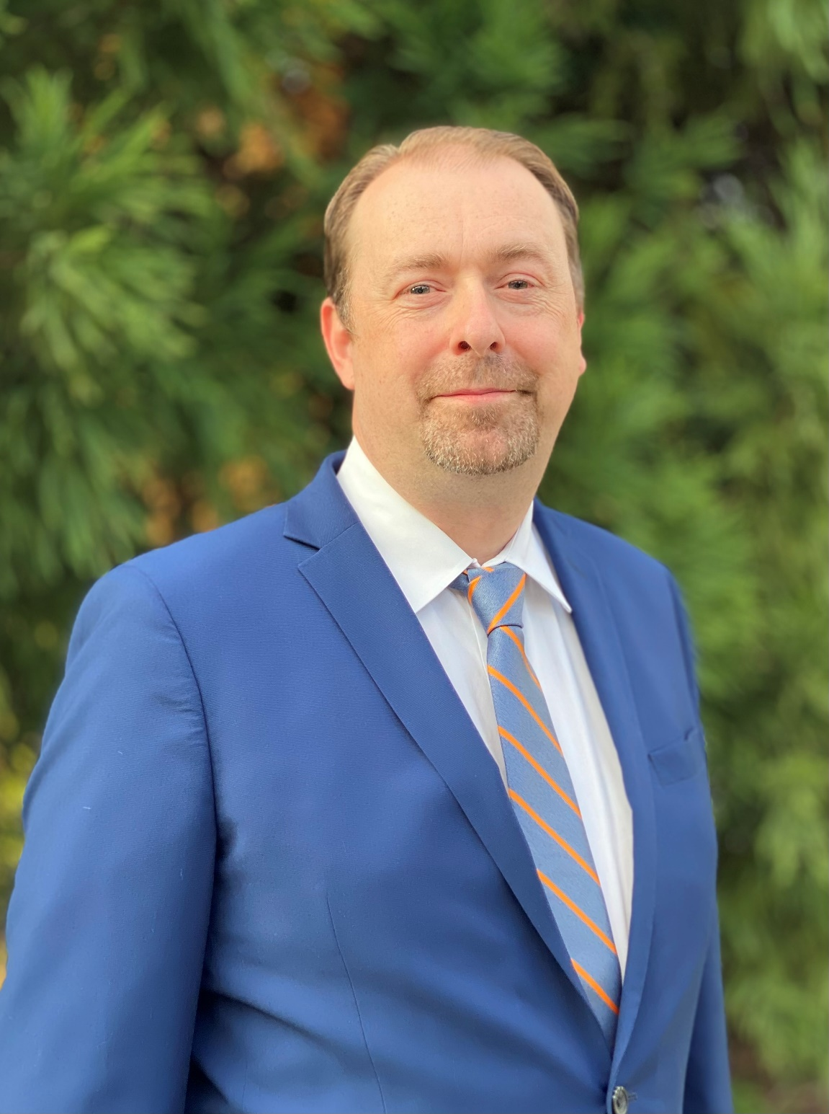
CHAPTER 04
Then I Got An IT Job…
Actually, quite a few of them.
IT, Cybersecurity, CISO, Elections, MS-ISAC, InfraGard, FBI, State Chief Risk Officer, Military, and more?

Slide 11
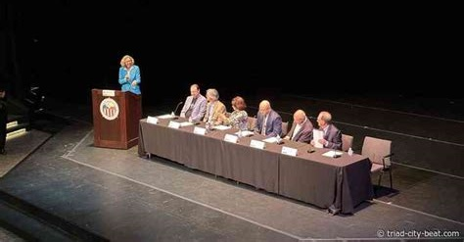


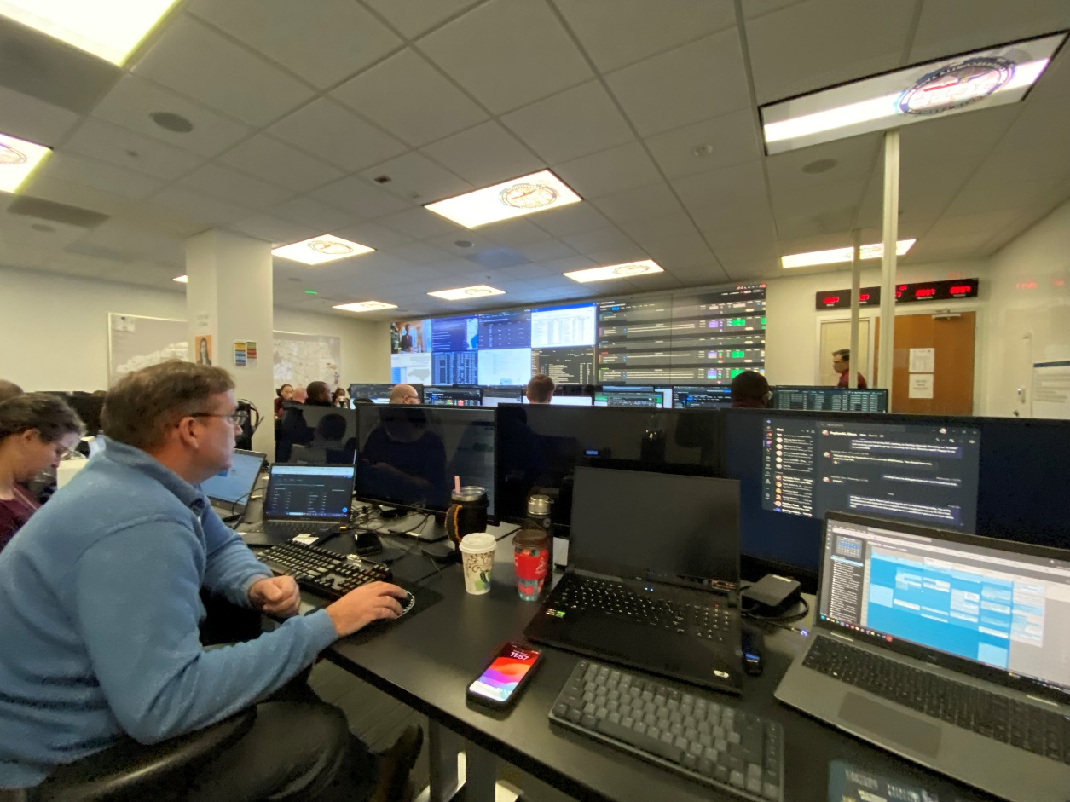
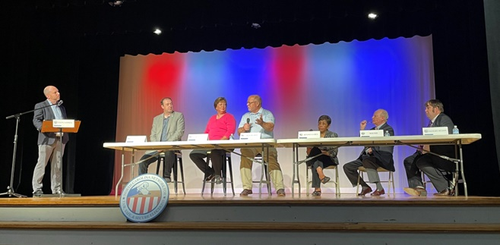
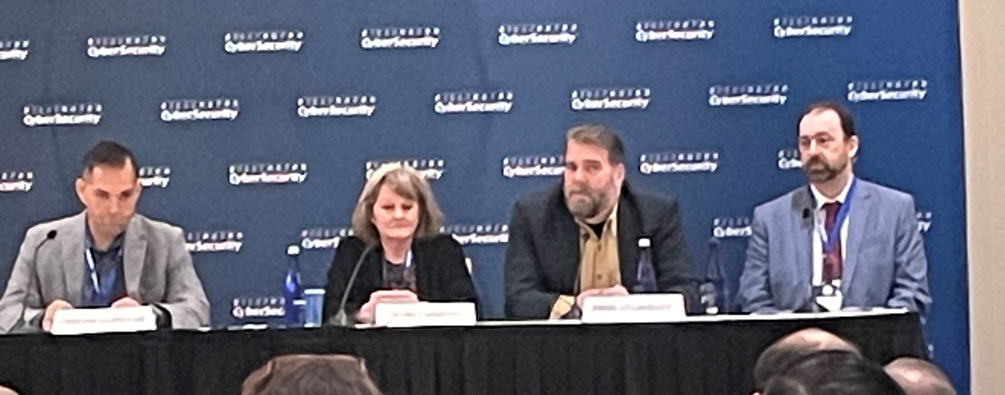
AUI, Elections, The Carter Center

Slide 12

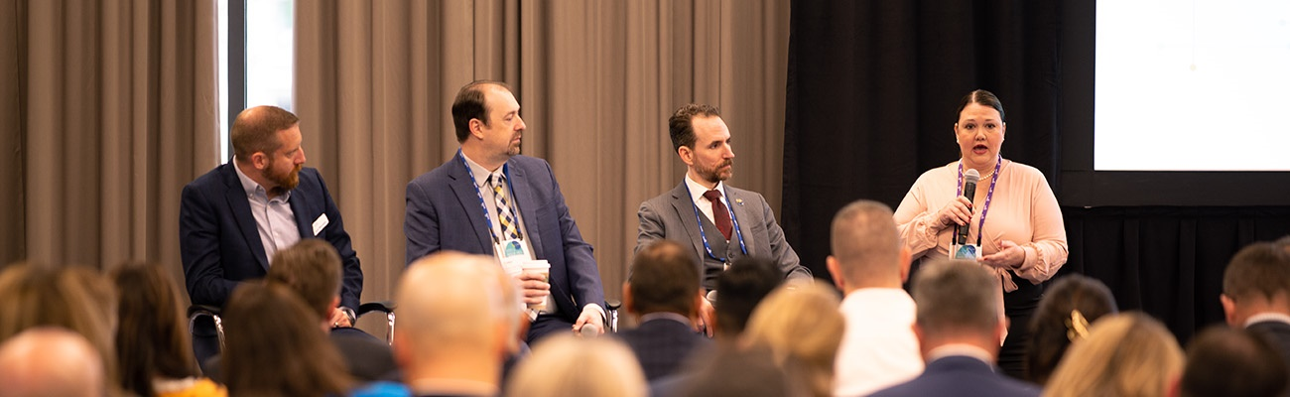

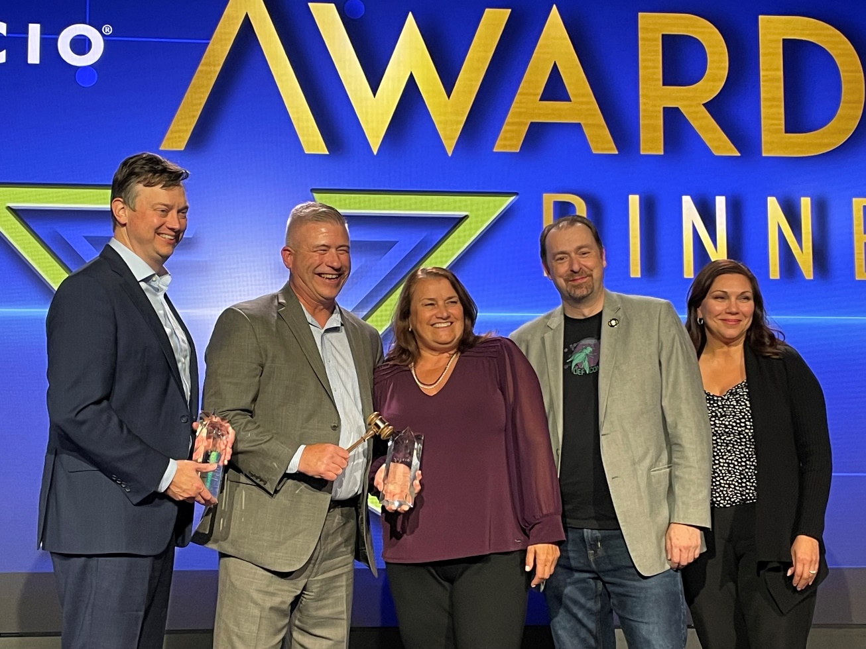
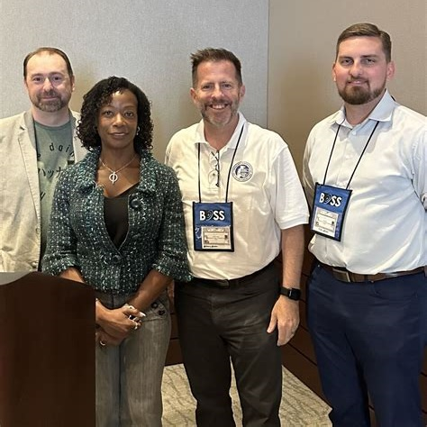
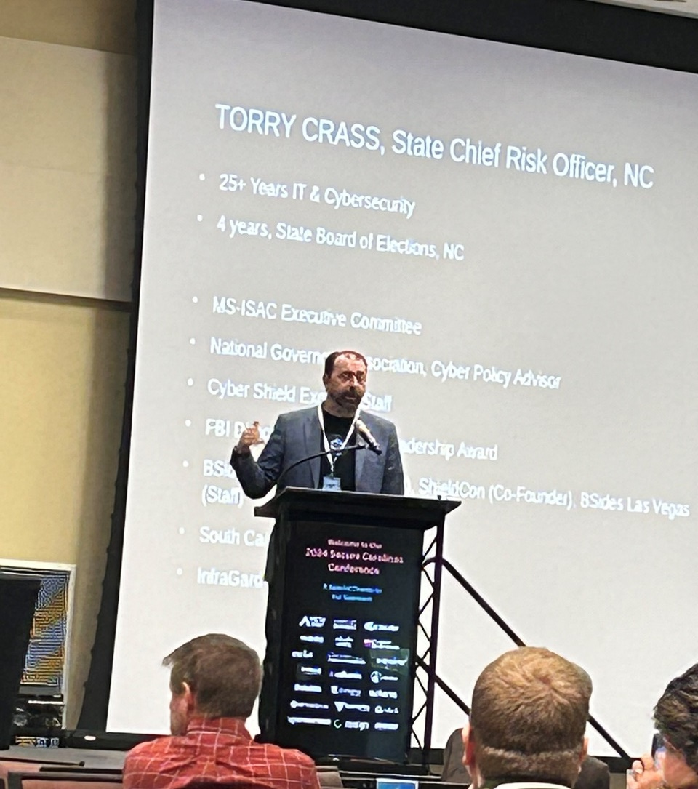

North Carolina State Chief Risk Officer

Slide 13
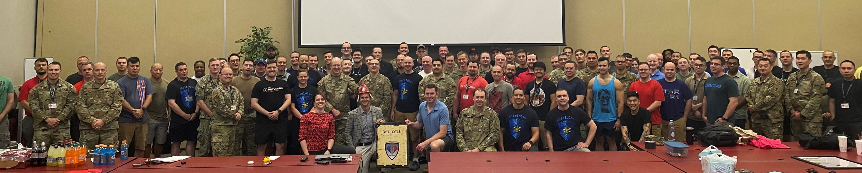

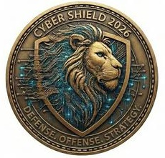
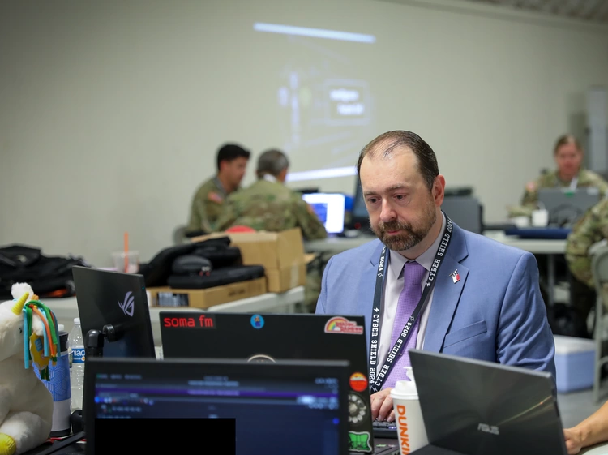

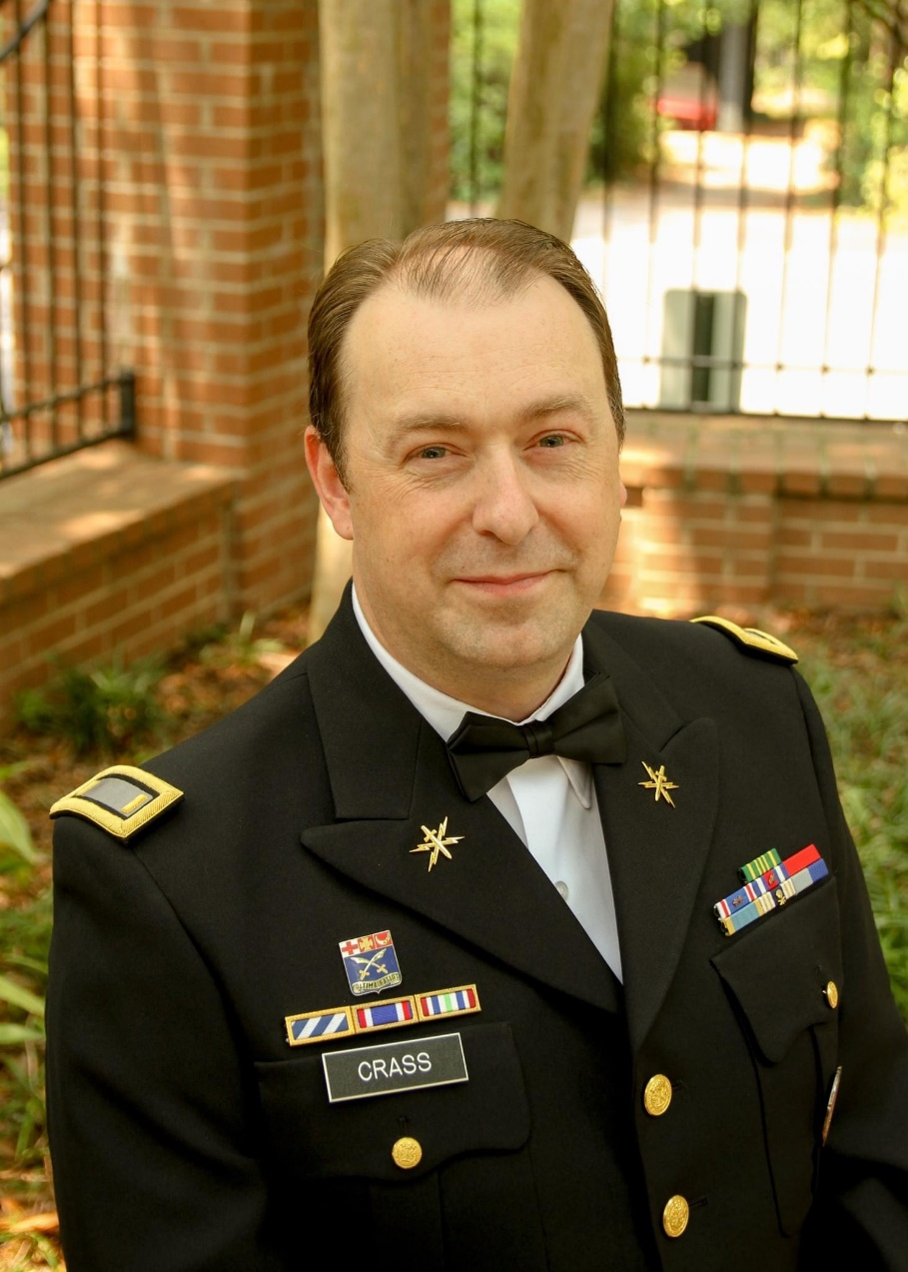
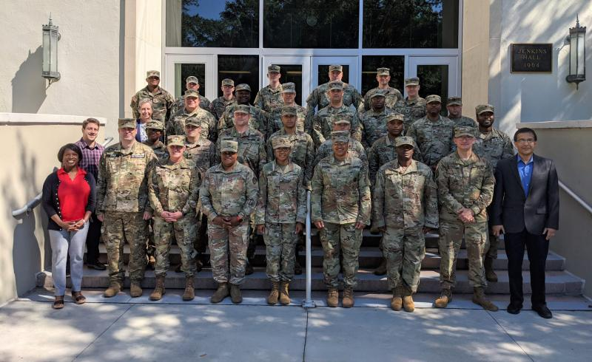
SCSG, Cyber Shield, The Citadel

Slide 14
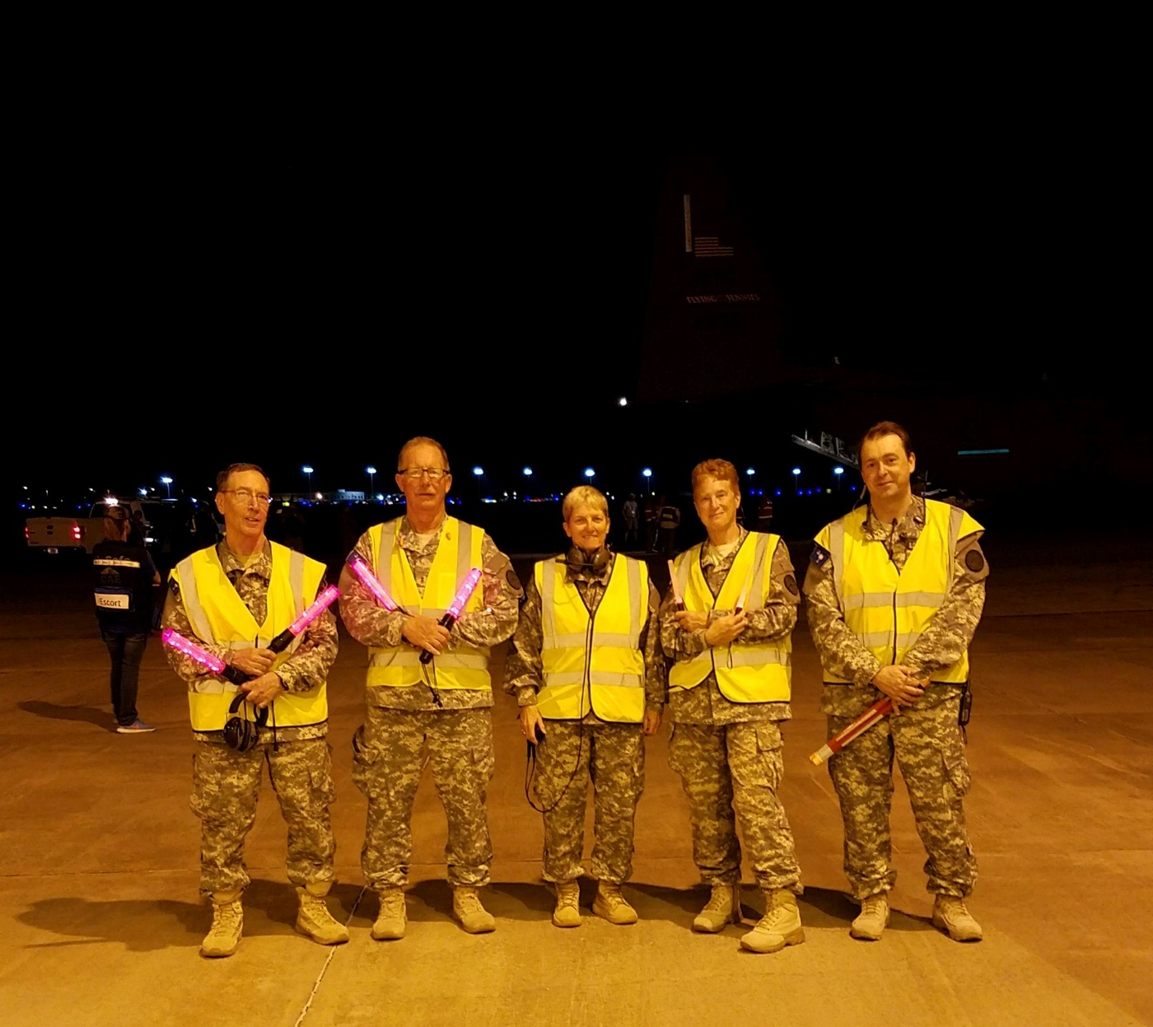
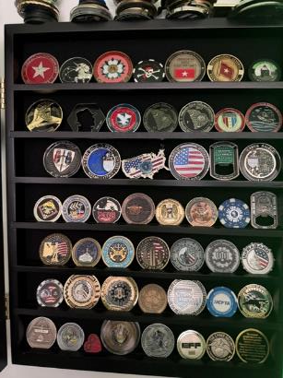
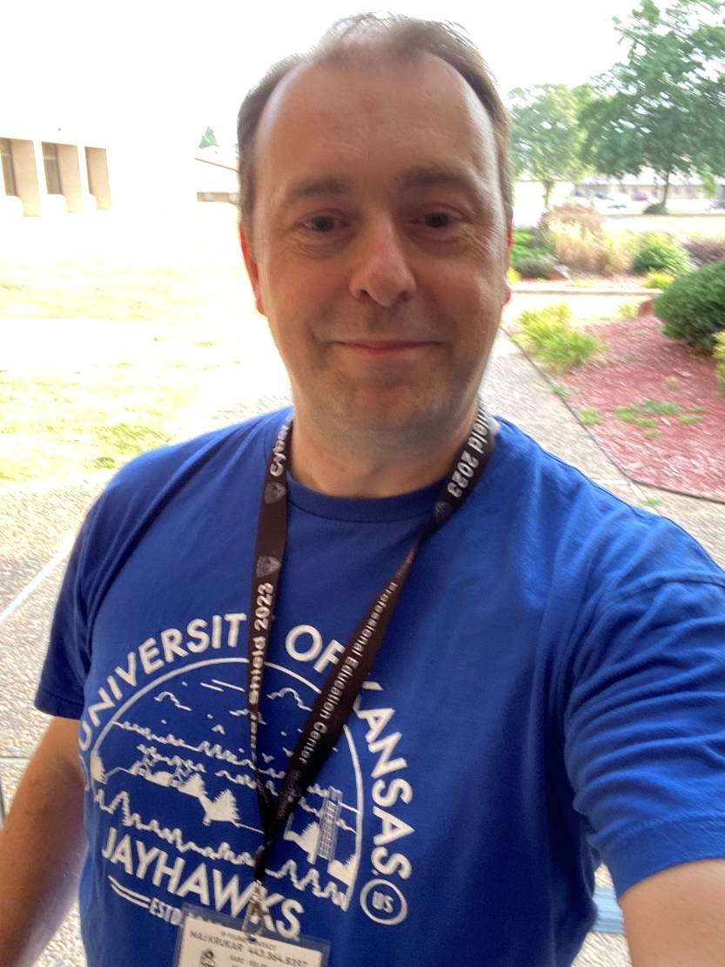
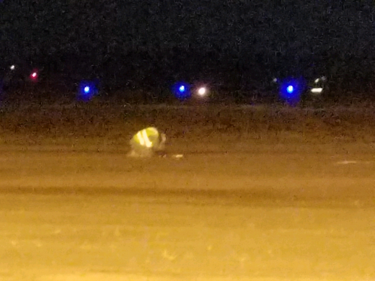
A Few Tokens, Hurricanes, Lessons Learned, Still Representing…

Slide 15
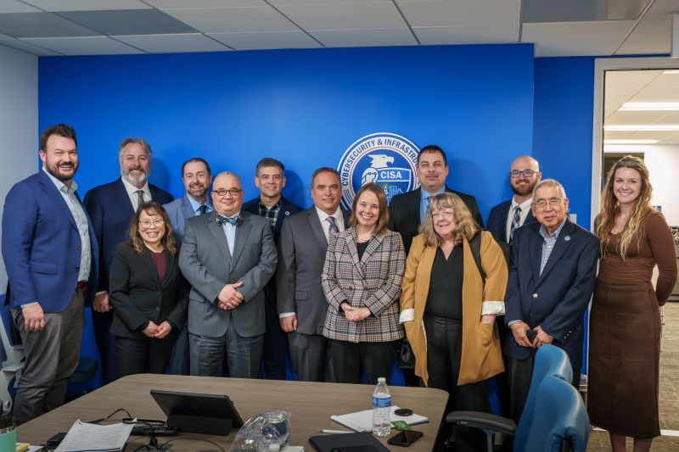

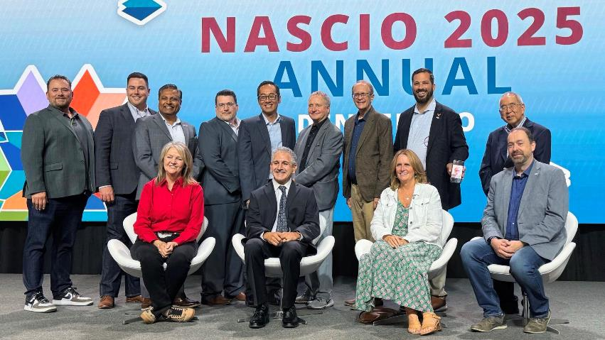

State CISO, MS-ISAC Executive Committee

Slide 16

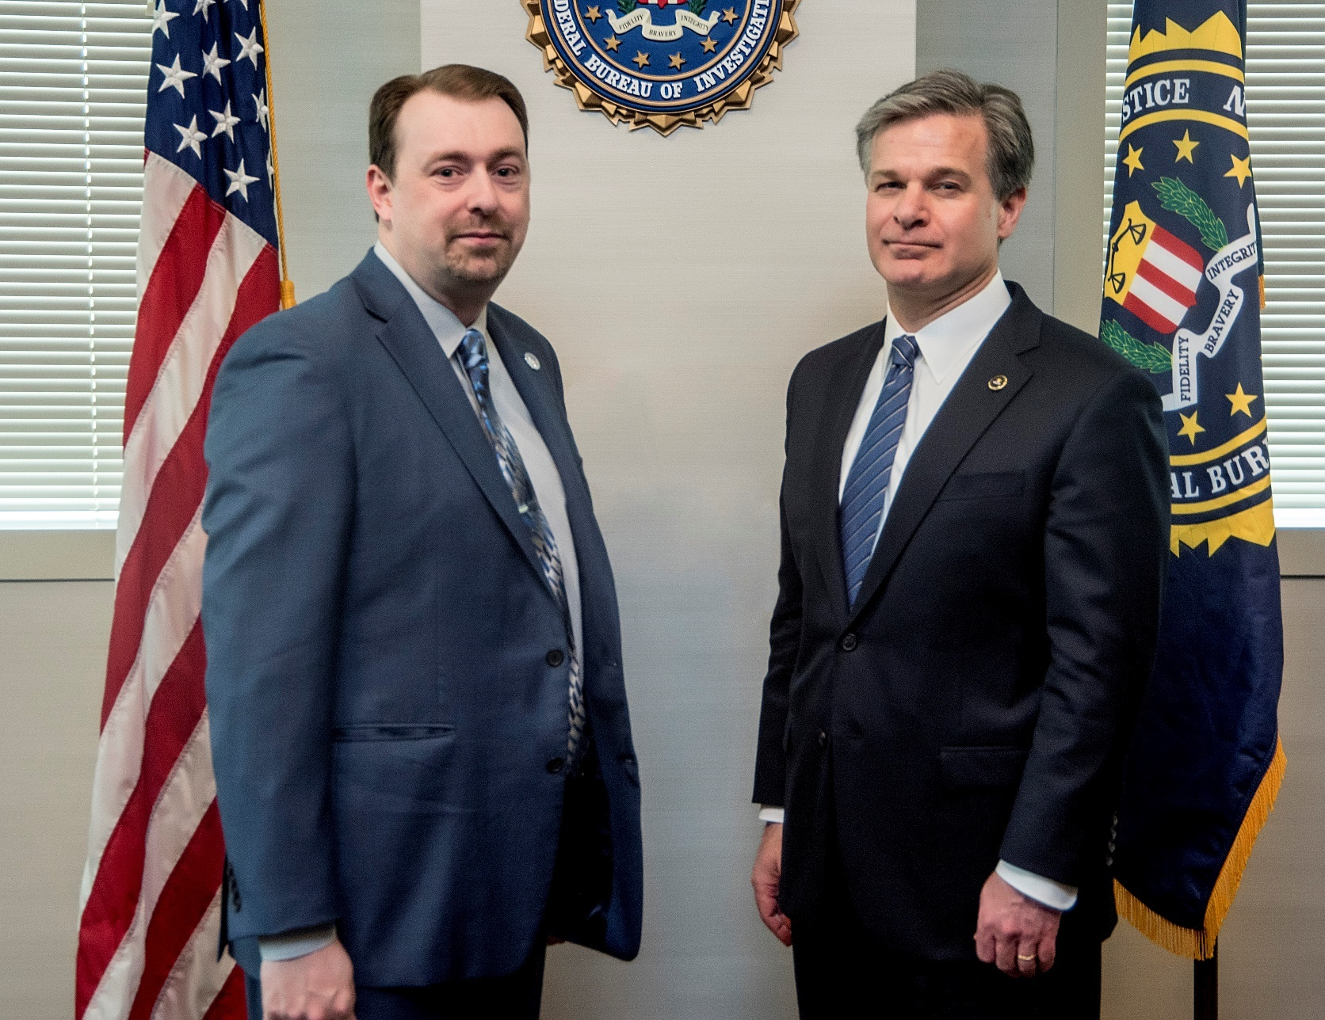

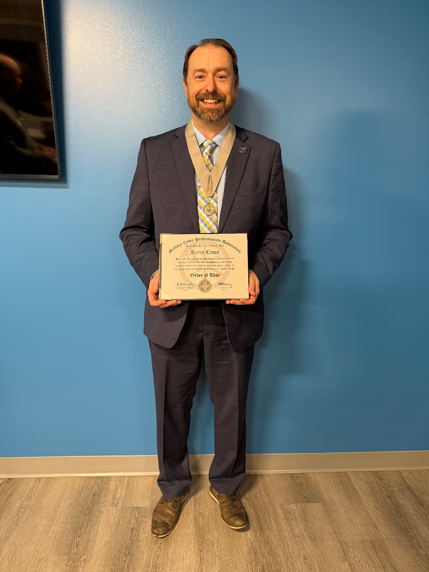
FBI, MCPA, Presidential Campaign Advisor

Slide 17

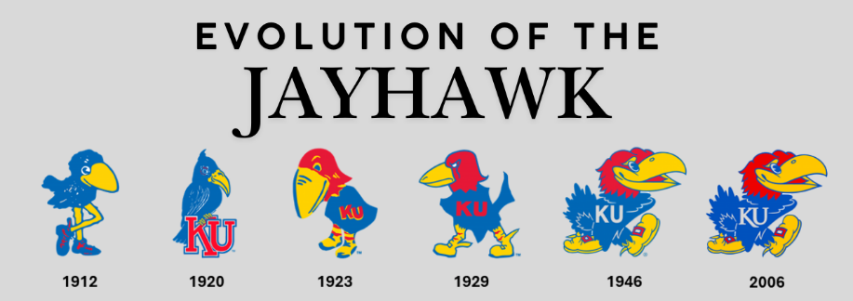
CHAPTER 06
Every now and then… You run into folks…
Multiple tracks. Parallel orbits. All pointing forward.

Slide 18
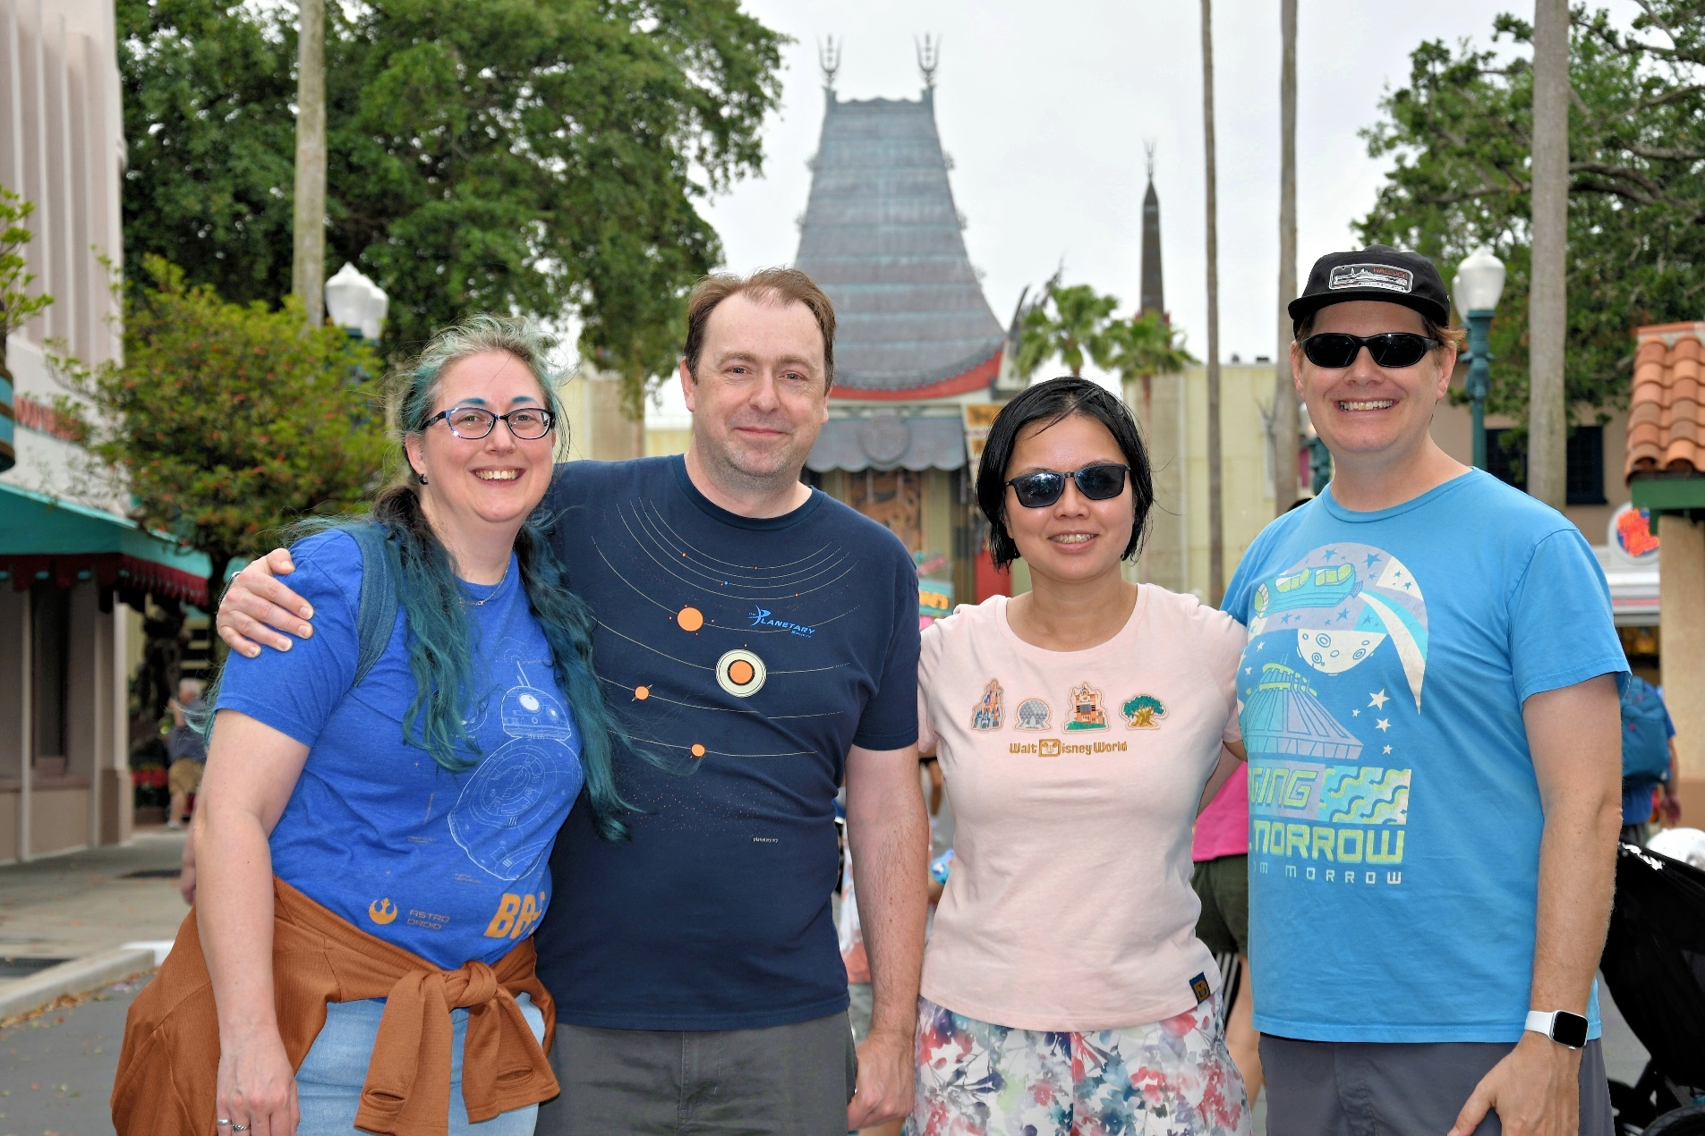
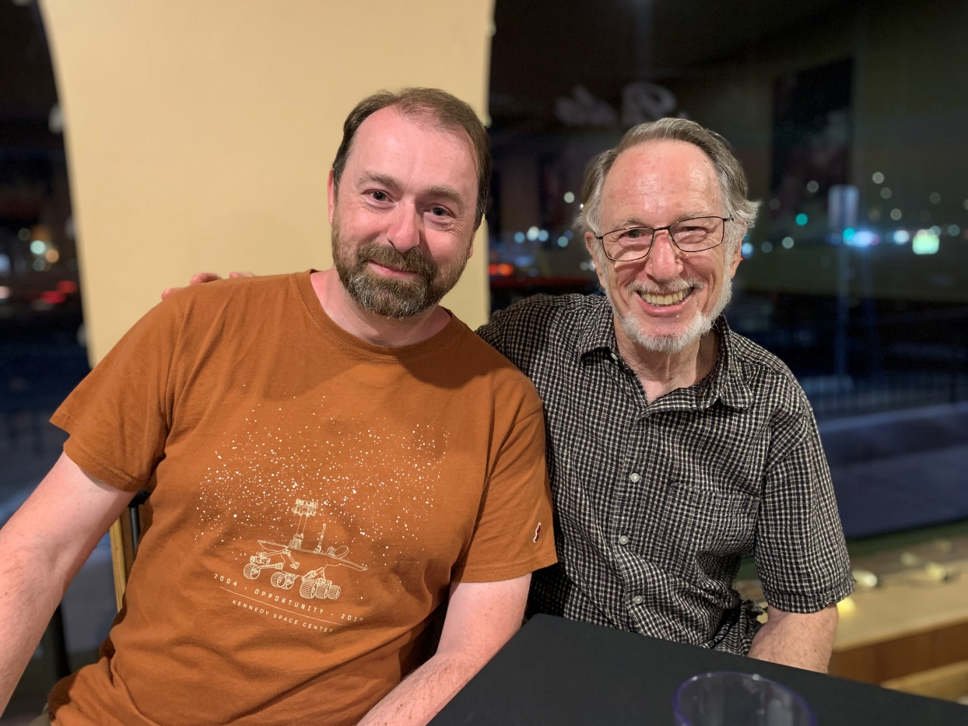
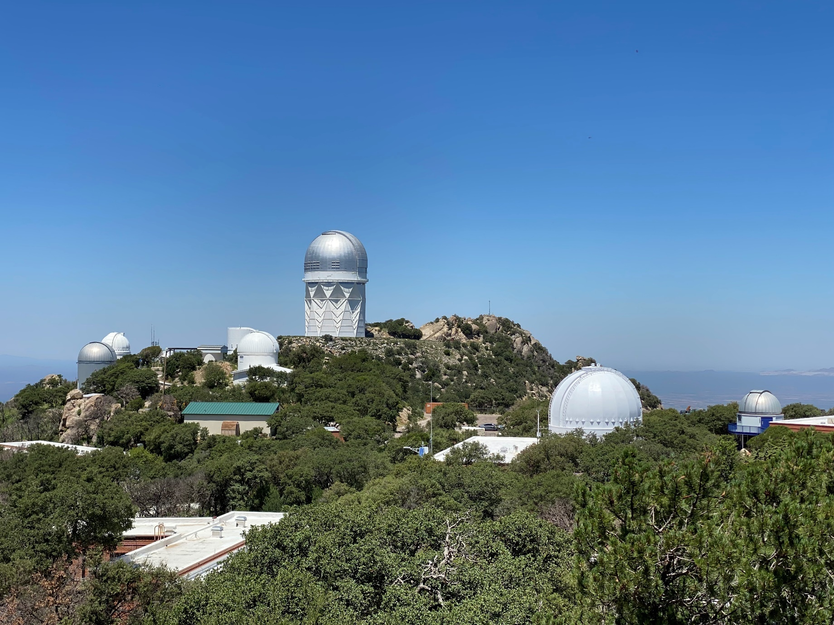
Jayhawks In The Wild… and trips to Kitt Peak, Lowell too…

Slide 19

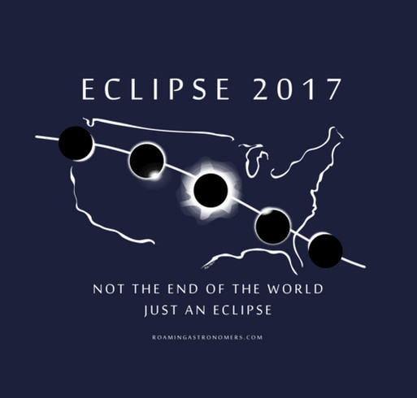
CHAPTER 05
Roaming Astronomers
Once in a while, when astronomy events bring us together…

Slide 20
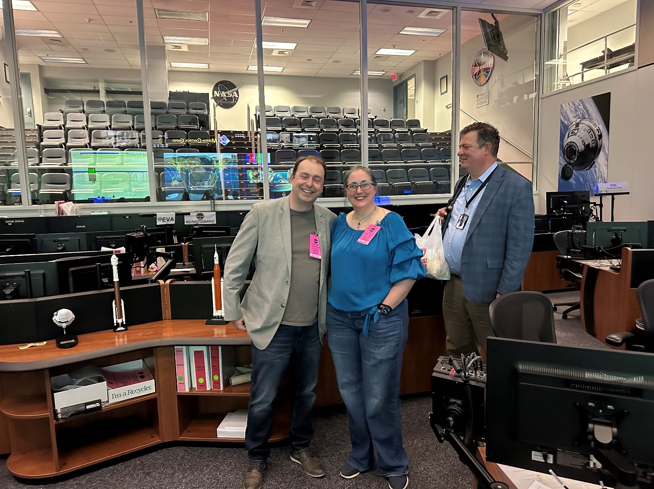
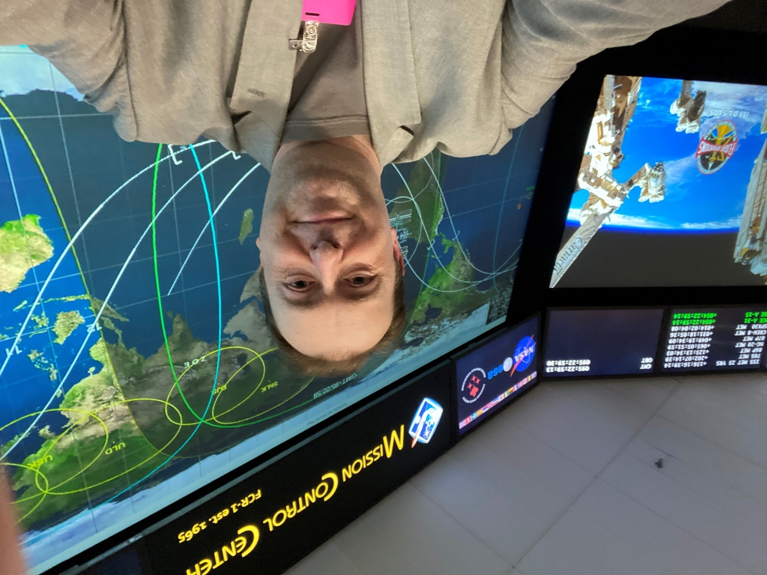
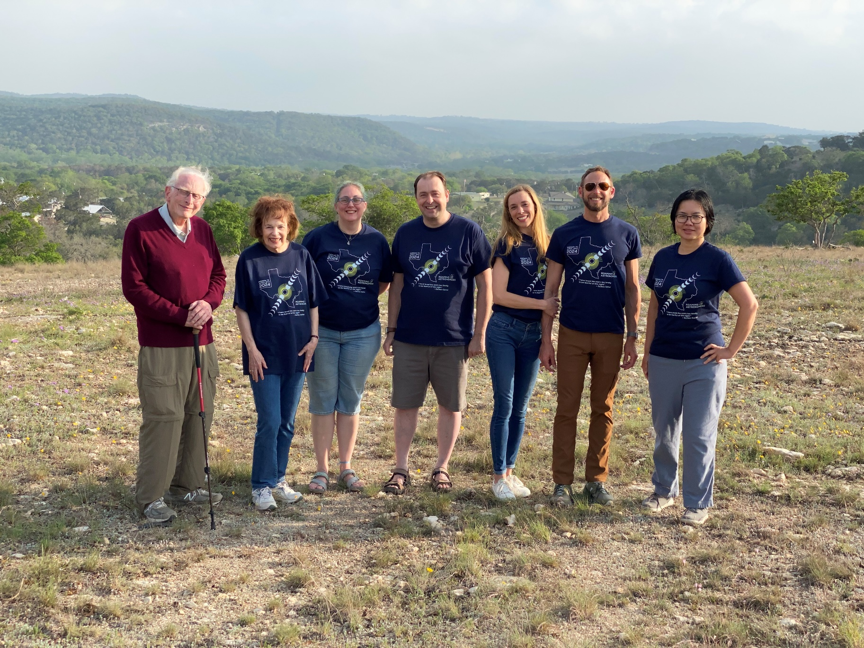

Mission Control, JHAPL, Flight Directors, and Roaming Astronomers

Slide 21



CHAPTER 07
Still Doing Astro Things
The degree paused, but some day…

Slide 22




My Own 6”… and 8”… and robotic… and…

Slide 23




Nebulae, Comets, Iceland Moonsets, and Finnish Aurora

Slide 24

RECORDED DEMONSTRATION

Slide 25




THANK YOU
Contact Information
torry.crass@outlook.com
torry.crass@insomnisec.com
LinkedIn QR Code
LinkedIn: linkedin.com/in/torrycrass
·
BlueSky: torrycrass@bsky.social
Mastodon: @plaintext@defcon.social
Questions welcome — astronomy, cybersecurity, or the strange paths that connect them.

